Slide 1

Assignment 3- Recommender Systems
Deepthi Suresh
S3991481
Notes:
Hello, My name is Deepthi Suresh and I will be presenting my finding from Assignment 3

Slide 2
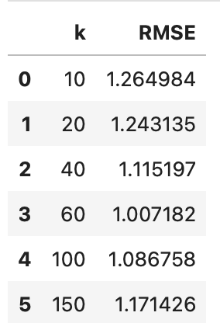
Key results and findings of Task 1
KNN Based Collaborative filtering is conducted based on the Pearson’s Correlation Similarity Matrix with different k values.
Based on the RMSE, the optimal value of k is found to be 60, as it has the lowest RMSE value. It can be noted that tuning k can significantly improve model accuracy.
KNN Based Collaborative filtering is also conducted based on Cosine Similarity and. Euclidian Distances
RMSE on Cosine Similarity (User-based): 1.13
RMSE on Euclidian Similarity (User-based): 1.41
Cosine similarity yields a significantly lower RMSE compared to Euclidian Similarity , making it the more better choice. However the Pearson’s Correlation Matrix with k = 60 provides the lowest RMSE of 1.007 and therefore is the best choice for this dataset and will be used for further analysis
Notes:
For task 1, I have created a KNN model based on the Pearson’s Correlation Similarity Matrix with different k values. RMSE which calculates the average prediction error in ratings is used as evualation metric in this case. Lower RMSE better is the performance of the model.
after multiple trial and error The optimal k values is found to be 60, with a RMSE of 1.007, the other k values and their RMSE is given in the table on the right.
For comparisons sake the KNN has been developed based on Cosine similarity measures and Euclidean distance measures as well .
It was interesting to note that Knn model with Cosine similarity matrix performed better than Euclidean distance measures , however both of these models underperformed while compared with the Pearson’s Correlation based KNN model

Slide 3
Description and explanation of approaches used in Task 2
According to Wikipedia, Matrix factorization is a class of collaborative filtering algorithms used in recommender systems that works by decomposing the user-item interaction matrix into the product of two lower dimensionality rectangular matrices.
The method of Matrix factorization used in this case is the SVD. The goal of Singular value decomposition [Gupta (2023)] is to find two new matrices, one representing users and the other representing items, that when multiplied together, approximate the original matrix as closely as possible.
SVD is a great technique for handling missing data, which is a common problem in recommender systems especially in datasets with 1M observations. SVD, can fill in missing ratings by using the latent representations of users and items to make predictions. With its ability to reduce dimensionality, it’s a great technique for large-scale recommendation systems[(GeeksforGeeks, 2024)].
In order to improve the SVD, I have decided to hyper tune the parameters [(Matrix Factorization-based Algorithms — Surprise 1 Documentation, n.d.-b)]. The following parameters are updated:
n_factors: The number of factors. Increases the number of latent factors to capture more complex relationships.
lr_all: - The learning rate for all parameters. A lower learning rate helps in gradual convergence.
reg_all - The regularization term for all parameters. Regularization to prevent overfitting, improving generalization on unseen data.
n_epochs: - The number of iteration. More training epochs allow the model to learn better from the data.
Notes:
Task 2 required us to implement, and evaluate a recommender system that uses a matrix factorization technique .
For this task I have decided to implement Singular Value Decomposition model. The goal of Singular value decomposition [Gupta (2023)] is to find two new matrices, one representing users and the other representing items, that when multiplied together, approximate the original matrix as closely as possible.
SVD is a great technique for handling missing data, which is a common problem in recommender systems. By using SVD, we can fill in missing ratings by using the latent representations of users and items to make predictions
In order to improve the SVD, I have decided to hyper tune the parameters

Slide 4
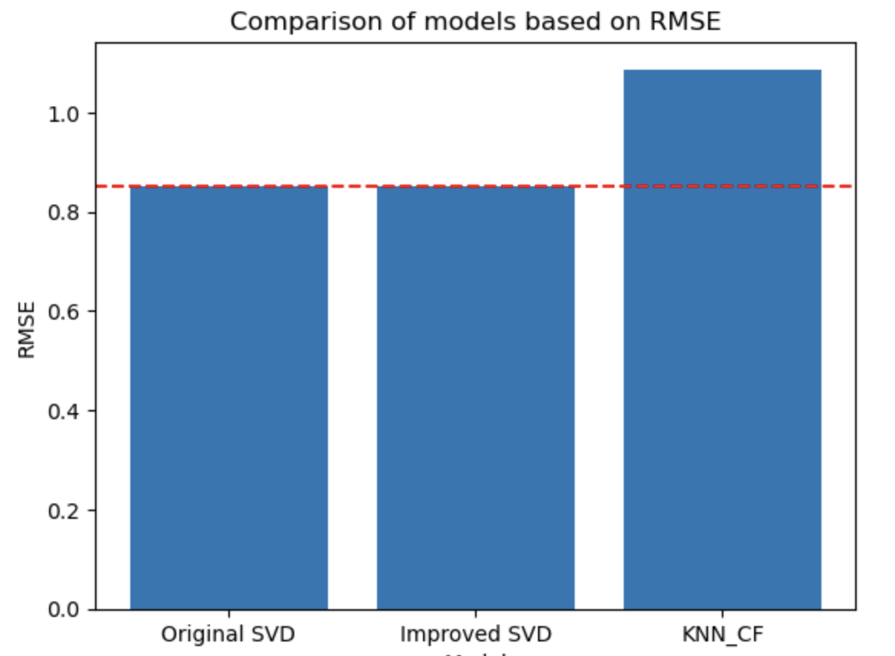
Key results and findings of Task 2
Fitting the SVD model after splitting the data into train and test dataset, without adding any parameters resulted in a RMSE of 0.87
Upon performing a grid search to hyper tune the SVD model resulted in the following parameters : {'n_factors': 150, 'lr_all': 0.005, 'reg_all': 0.08, 'n_epochs': 120} and an updated RMSE of 0.85. There is a slight improvement in the model
Comparison with the KNN model shows, the the Matrix Factorisation methods gives significantly lower RMSE and therefore better predictions.
Notes:
The initial SVD model without any parameters resulted in a RMSE of 0.87
performing a grid search to hyper tune the SVD model resulted in the identifying the optimal parameters as mentioned in point 2. This resulted in an updated RMSE of 0.85 which indicates a slight improvement in the model
The reason This Approach Works could be the: Increased Capacity: because of the additional factors that can model better user preferences thereby enhancing prediction accuracy.
Another reason could be Regularization improvements which Balances the complexity of the model, preventing overfitting in a sparse dataset
More iterations ensure the model captures the underlying patterns in the data without losing relevant information.
Comparison with the KNN model shows, the the Matrix Factorisation methods gives significantly lower RMSE and therefore better predictions.

Slide 5
Discussions and explanation of Task 3
In Task 3, IMFR and KNN (k=60) has been used to recommend the top 20 movies for 10 random users.
The recommendations are done based on the prediction made by each of the models
The models are then evaluated based on AP and NDGC
Average precision metric tries to calculates the precision at every location 1 through k where there is a relevant item.
NDCG measures the overall reward at all positions that hold a relevant item. The reward is an inverse log of the position (i.e. higher ranks for relevant items would lead to better reward, as desired).
In this task, the focus is on the “what order is best”.
Notes:
In Task 3 ranking based evaluation is conducted on the KNN and IMFR model that was tuned and slected in the previous tasks.

Slide 6
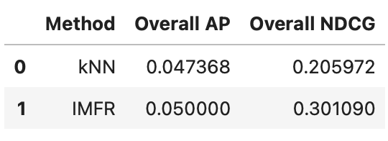
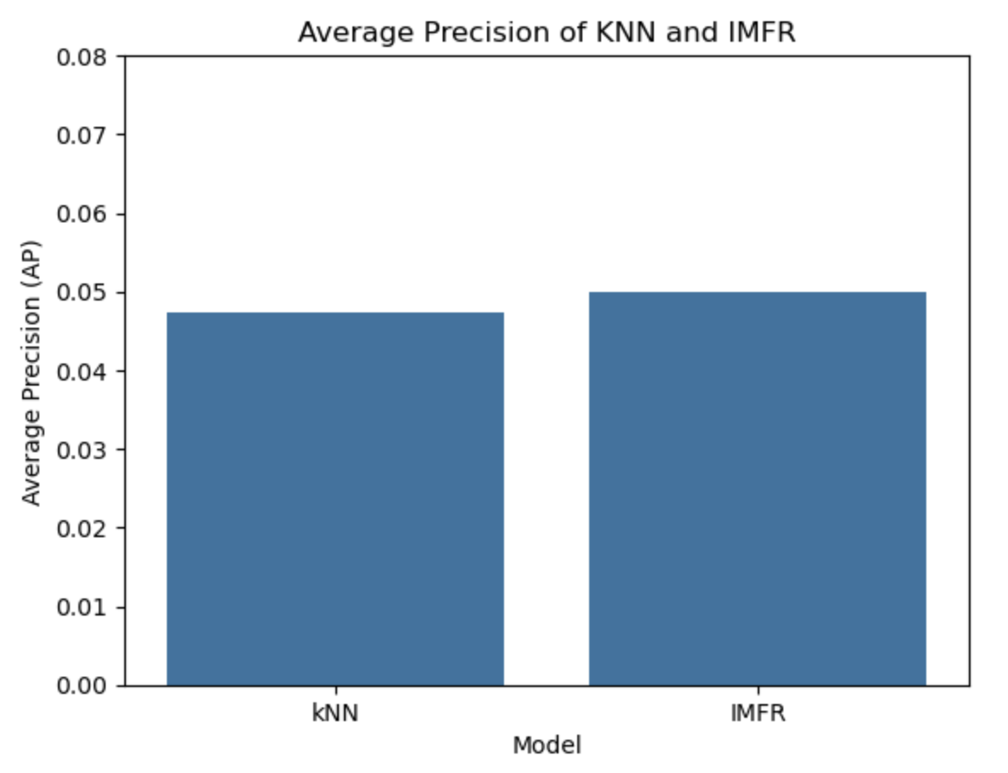
Visualisation of AP
Average Precision gives us an interpretable understanding of how many items are actually relevant in the final k recommendations we show to a user.
A higher AP indicates that more relevant items are present among the top recommendations, thus enhancing user satisfaction.
The IMFR method achieved an AP of 0.05, which is slightly higher than the average precision of 0.04 achieved by kNN.
This indicates that IMFR is slightly better at retrieving relevant recommendations among the top predictions compared to kNN
Notes:
Moving on to the visualisation of AP, we can see that The IMFR method achieved an AP of 0.05, which is slightly higher than the average precision of 0.04 achieved by kNN. A higher AP indicates that more relevant items are present among the top recommendations,. This is because AP gives us an understanding of how many items are actually relevant in the recommendations we show to a user. A higher AP for IMFR indicates that IMFR is slightly better at retrieving relevant recommendations among the top predictions compared to kNN

Slide 7
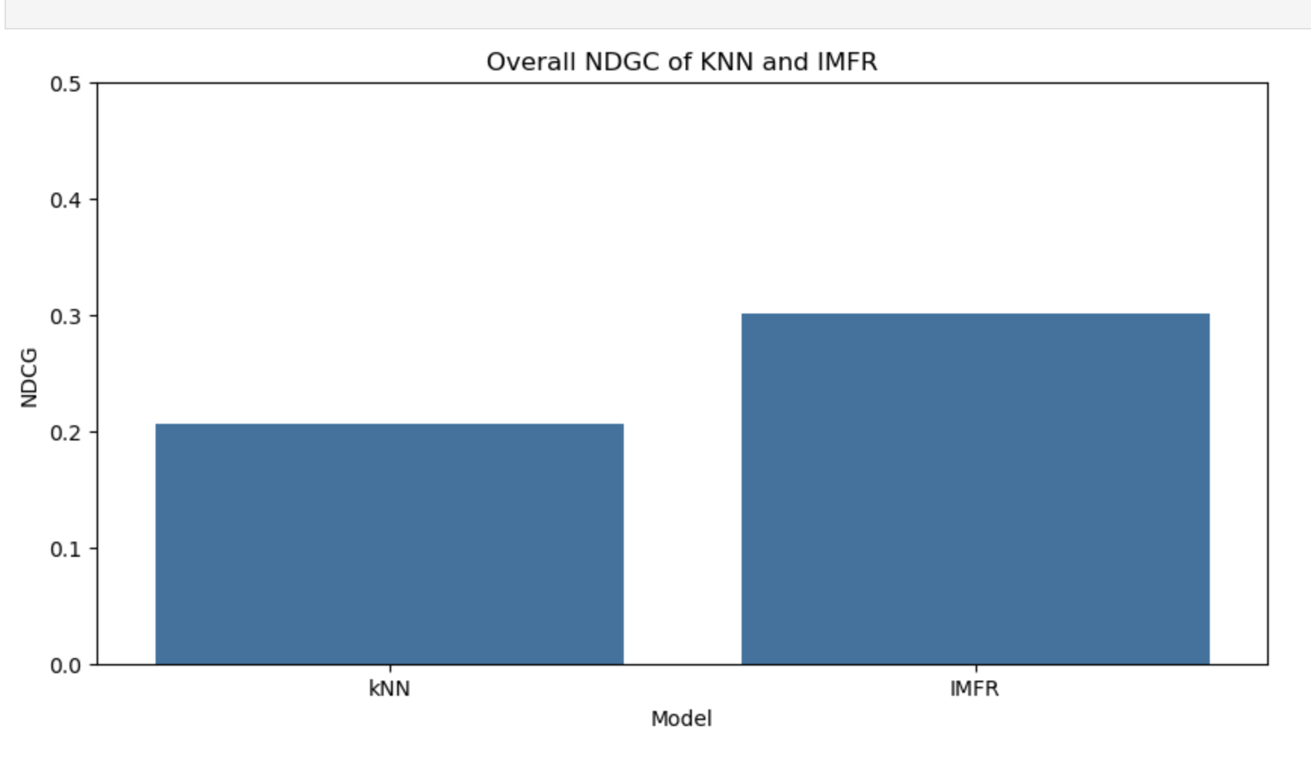
Visualisationof NDCG
The rationale behind NDCG is to prioritize the most relevant items at the top of the list.
The NDCG score for IMFR is 0.3, slightly higher than 0.2 for kNN.
This suggests that IMFR provides better-ranked recommendations, meaning that relevant items are positioned higher in the list for users.
Notes:
Coming to The NDCG score, the score for IMFR is 0.3, which is slightly higher than 0.2 for kNN. The rationale behind NDGC is to prioritize the most relevant items at the top of the list. A higher score in IMFR indicates that IMFR provides better-ranked recommendations, meaning that relevant items are positioned higher in the list for users.

Slide 8
Limitations of KNNCF
KNN has a high computational expense, especially when the dataset is huge. The MovieLens 1M dataset contains over 1 million ratings, As the user base grows, the computational cost of calculating similarities between users or items also escalates significantly.
KNN is highly sensitivity to the choice of. A small k can cause overfitting and high variance, while a large k can lead to underfitting and high bias.
As new users are added, KNN faces the issue of Cold start. Without any historical data, it cannot generate any recommendations
The 1M Movielens data is extremely sparse. The kNN method struggles with sparse datasets, where several users have rated only a few items or not rated any movies.
Parameter Tuning is an excellent way of improving the performance of KNNCF, especially by identifying the optimal k value.
Another way KNNCF Can be improved is by creating Hybrid methods of either content based filtering or other methods under collaborative filtering.
Notes:
One of the major limitation of KNN is the scalability issue., especially while compute pirwise similarities with every other users for a huge dataset, This involves extensive computational requirements.
KNN is also highly sensitivity to the choice of K. A small k can cause overfitting, while a large k can lead to underfitting.
KNN faces the issue of Cold start asThe MovieLens dataset is continually growing and also is sparse. . Without any historical data, it cannot generate any recommendations leading to irrelevant or no recommendations at all.
KNN can be improved by parameter tuning which is what I have done.
. Another way KNNCF Can be improved is by creating Hybrid methods of either content based filtering or other methods under collaborative filtering which can enhance recommendation quality

Slide 9
Why can IMFR deliver a better performance?
Matrix factorization methods scale better with large datasets, as they decompose the user-item matrix into lower-dimensional representations, therefore improving the efficiency and scalability of the model
IMFR performs better in sparse environments by filling in missing values and predicting unseen ratings without relying solely on explicit ratings.
IMFR can identify hidden characteristics that influence user preferences and item attributes as it converts matrices into latent features, therefore handling the cold start problem
IMFR can easily incorporate new features compared to traditional KNN
Notes:
Why can IMFR deliver better performance? IMFR methods decompose the user-item matrix into lower-dimensional representations, which helps with a huge dataset like MovieLens by reducing the computational complexity.
IMFR addresses the challenge of sparse dataset by predicting unseen ratings based on patterns learned from the existing ratings. This capability enables the model to make informed recommendations even for users or movies with limited interaction data.
This also helps in handling the cold start problem that Knn faces.
IMFR can easily incorporate new features compared to traditional KNN, where adding new features can complicate the similarity calculations and require significant retraining

Slide 10
References
Cheng, Z. (2022, June 29). A comparison of cosine similarity vs Euclidean distance in ALS recommendation engine. Medium. https://medium.com/nerd-for-tech/a-comparison-of-cosine-similarity-vs-euclidean-distance-in-als-recommendation-engine-51898f9025e7
Collaborative filtering advantages & disadvantages. (n.d.). Google for Developers. https://developers.google.com/machine-learning/recommendation/collaborative/summary
Difference between zip(list) and zip(*list). (n.d.). Stack Overflow. https://stackoverflow.com/questions/29139350/difference-between-ziplist-and-ziplist
Evaluating Recommendation Systems - Precision@k, Recall@k, and R-Precision | Shaped Blog. (n.d.). https://www.shaped.ai/blog/evaluating-recommendation-systems-part-1
Flateman, J. (2022, January 3). Using Surprise in Python with a recommender system - Jonah Flateman - Medium. Medium. https://medium.com/@jonahflateman/using-surprise-in-python-with-a-recommender-system-2d6030140926
GeeksforGeeks. (2024, June 20). SVD in recommendation systems. GeeksforGeeks. https://www.geeksforgeeks.org/svd-in-recommendation-systems/
Getting Started — Surprise 1 documentation. (n.d.). https://surprise.readthedocs.io/en/stable/getting_started.html#tune-algorithm-parameters-with-gridsearchcv
Gupta, R. (2023, January 18). How Singular Value Decomposition (SVD) is used in Recommendation Systems, “Clearly Explained”. Medium. https://medium.com/@ritik_gupta/how-singular-value-decomposition-svd-is-used-in-recommendation-systems-clearly-explained-201b24e175db
Hug, N. (n.d.). Home. Surprise. https://surpriselib.com/
Kapre, S. (2022, January 1). Common metrics to evaluate recommendation systems - Sangram Kapre - Medium. Medium. https://flowthytensor.medium.com/some-metrics-to-evaluate-recommendation-systems-9e0cf0c8b6cf
Matrix Factorization-based algorithms — Surprise 1 documentation. (n.d.-a). https://surprise.readthedocs.io/en/stable/matrix_factorization.html
Matrix Factorization-based algorithms — Surprise 1 documentation. (n.d.-b). https://surprise.readthedocs.io/en/stable/matrix_factorization.html#surprise.prediction_algorithms.matrix_factorization.SVD
Python sorted(). (n.d.). https://www.programiz.com/python-programming/methods/built-in/sorted
Recommenders-Team. (n.d.-a). recommenders/examples/02_model_collaborative_filtering/surprise_svd_deep_dive.ipynb at main · recommenders-team/recommenders. GitHub. https://github.com/recommenders-team/recommenders/blob/main/examples/02_model_collaborative_filtering/surprise_svd_deep_dive.ipynb
Recommenders-Team. (n.d.-b). recommenders/examples/02_model_collaborative_filtering/surprise_svd_deep_dive.ipynb at main · recommenders-team/recommenders. GitHub. https://github.com/recommenders-team/recommenders/blob/main/examples/02_model_collaborative_filtering/surprise_svd_deep_dive.ipynb
What are some challenges and limitations of KNN-based predictive models? (2023, November 4). www.linkedin.com. https://www.linkedin.com/advice/0/what-some-challenges-limitations-knn-based
Wikipedia contributors. (2024, August 23). Matrix factorization (recommender systems). Wikipedia. https://en.wikipedia.org/wiki/Matrix_factorization_(recommender_systems)

